Slide 1




Slide by: Andrew

Slide 2

Meet the Crew
Dylan Clarke - Climbs V6
Andrew Eardley - Programs in C
Hayden Jones - PLACEHOLDER
Hannah Martin - PLACEHOLDER
Joshua Rogers - Conquered Mt. Kilimanjaro
Together we bring technical expertise, creative design, and cohesive teamwork
Slide by: Andrew

Slide 3
Overview of Our Idea
Crews on the open sea need a way to connect with each other. Our service makes sure messages-in-bottles get from one lonely sailor to the next.
Slide by: Andrew
Notes:
The "Overview" including both the problem and solution might steal thunder from the Business Context segment. I reduced it to be a little more vague about the problem and its solution.

Slide 4
The Problem: A Missing Community Space
Current social media platforms serve broad audiences, but lack tailored spaces for unique subcultures.
There's no space for pirates to build their community online.
Without a platform these communities remain fragmented across ships and in scattered groups.
This gap leaves unmet demand for a social space built around identity, lifestyle, and shared storytelling.
Slide by: Hannah Martin

Slide 5
The Solution:
Plundr is a social media platform designed exclusively for pirates.
Features a thematic environment that emphasizes treasure, adventure, and camaraderie.
Provides core community tools: profiles, feeds, media sharing, and group spaces.
Builds user loyalty by fostering belonging and shared culture.
Slide by: Hannah Martin

Slide 6
Why it Matters
Proof of Concept: Plundr demonstrates how niche social platforms can thrive where large platforms overlook specific communities.
Market Potential: By targeting a distinct audience, Plundr can grow organically and expand into other themed communities.
Investor Value: Low-risk entry into the broader trend of 'micro-social' networks, with a clear differentiation from mainstream platforms.
Slide by: Hannah Martin

Slide 7
In-Scope Features V1.0
Account creation using a username and password and age verification (required)
Granted user sessions to avoid re-logging in
Profile creation: photos, bios, any other info that will be displayed to other profiles
Tavern chat: public, chaotic chatroom for open discussions
Crew system: Follow other pirates, form "crews," and share updates within your circle.
Slide by: Dylan Clarke

Slide 8
More In-Scope Features V1.0
Direct messaging with crewmates
Forum creation\editing, posting, and replying
Joining forums, bookmarking, and saving
Forum navigation
Forum hierarchy including an owner/creator, members, and moderators(out of scope?)
Account deletion
Logging out
Slide by: Dylan Clarke

Slide 9
Out-of-Scope for Version 1.0
Crew permissions/roles
Trending posts and replies
Treasure posts geotagged on a stylized map
Treasure-sharing leaderboards
Notification Filters for forums
Seasonal events: Treasure hunts, themed post challenges
Slide by: Dylan Clarke

Slide 10
Solution Architecture
Flask web server: handles routing client requests and web app functions
SQLite database: stores user, match, and message records
Flask-SocketIO: enables real-time chat and push notifications
Local file storage: profile pictures and other large files
Rustic CSS: enhanced for pirate seafaring aesthetic
Simple interface: reminiscent of early chat forums, easy to use
Slide by: Hayden Jones

Slide 11
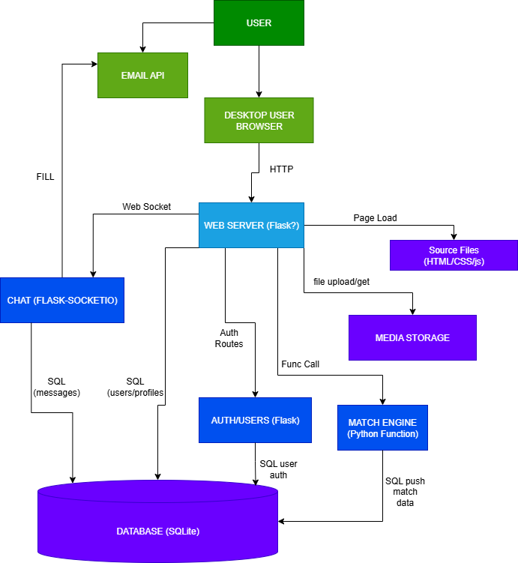
Component Diagram
Slide by: Hayden Jones

Slide 12
UX Design Focus for v1.0
Accessibility: Clear navigation, intuitive modern layouts.
Consistency: Uniform styling for predictability.
Simplicity: Essential features prioritized over cluttered novelty for the sake of merely being quirky.
Scalability: Anticipating future features.
Engagement: Theme reasonably enhances enjoyment but never distracts.
Slide by: Joshua Rogers

Slide 13
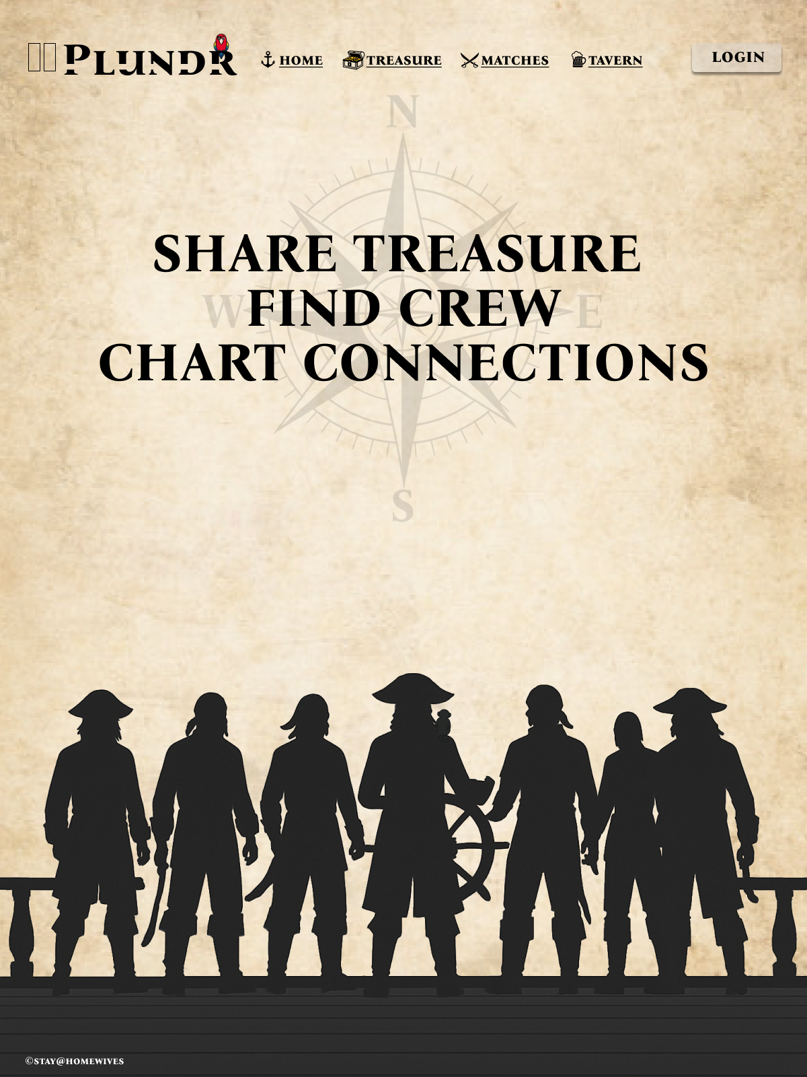
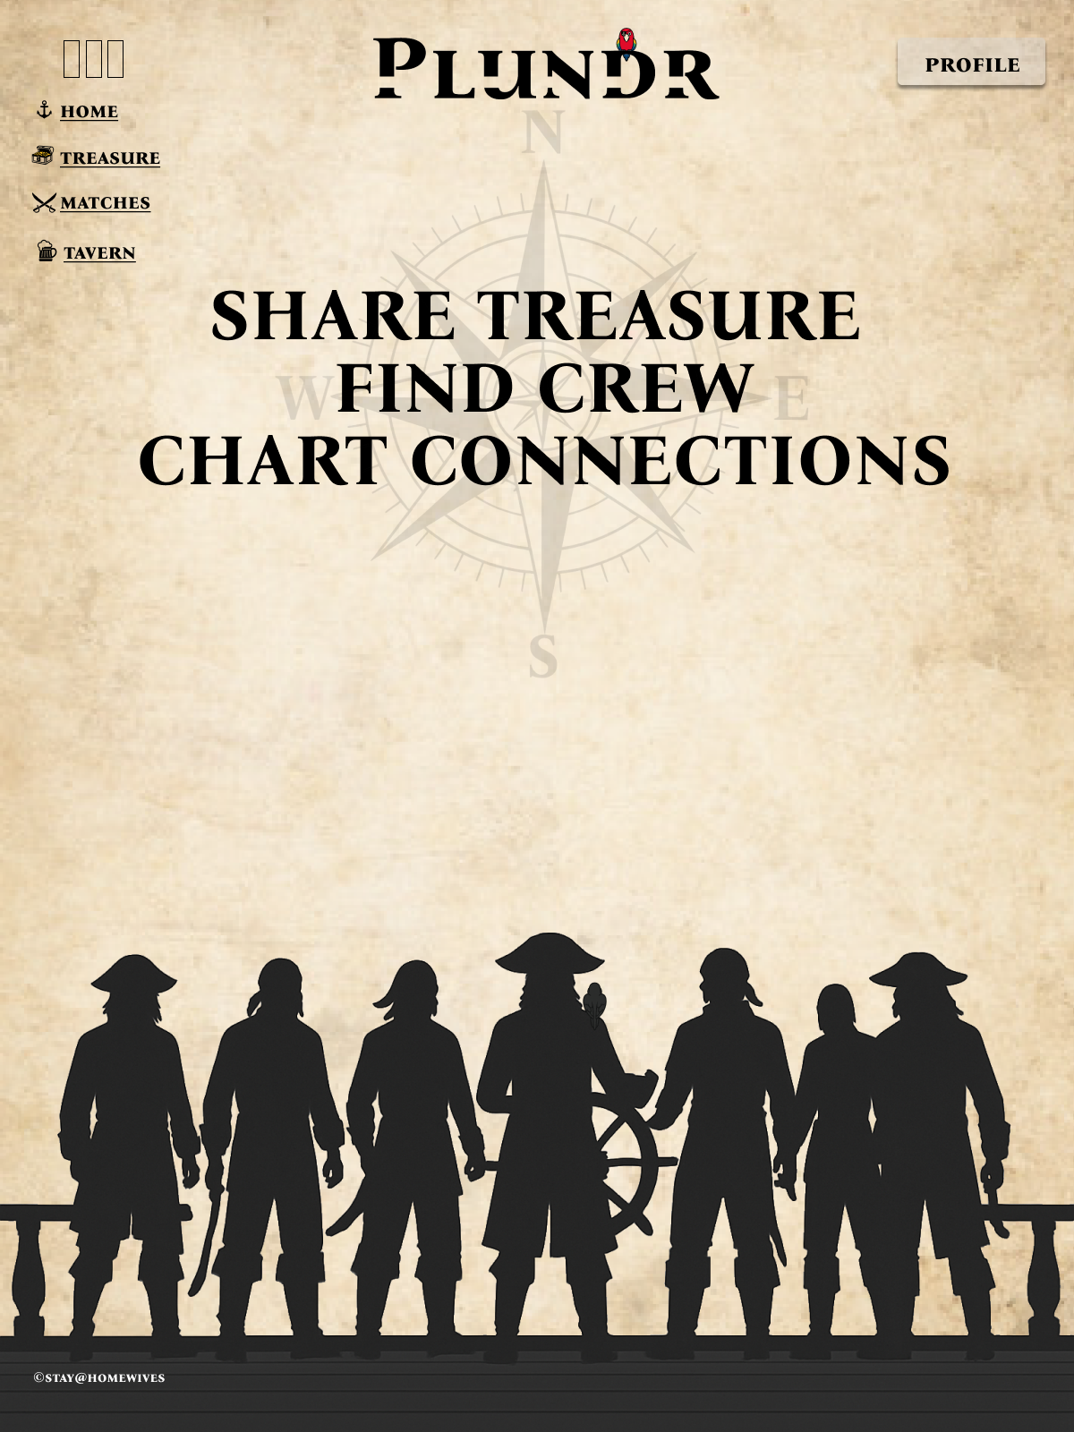
UI Mockup
Slide by: Joshua Rogers

Slide 14
Summary & Conclusion
Problem: There's no space online where new-age pirates can share their plunder and build community.
Solution: Plundr is a social platform themed around treasure, adventure, and camaraderie.
It's a proof of concept for niche community platforms.
Slide by: Joshua Rogers

Slide 15
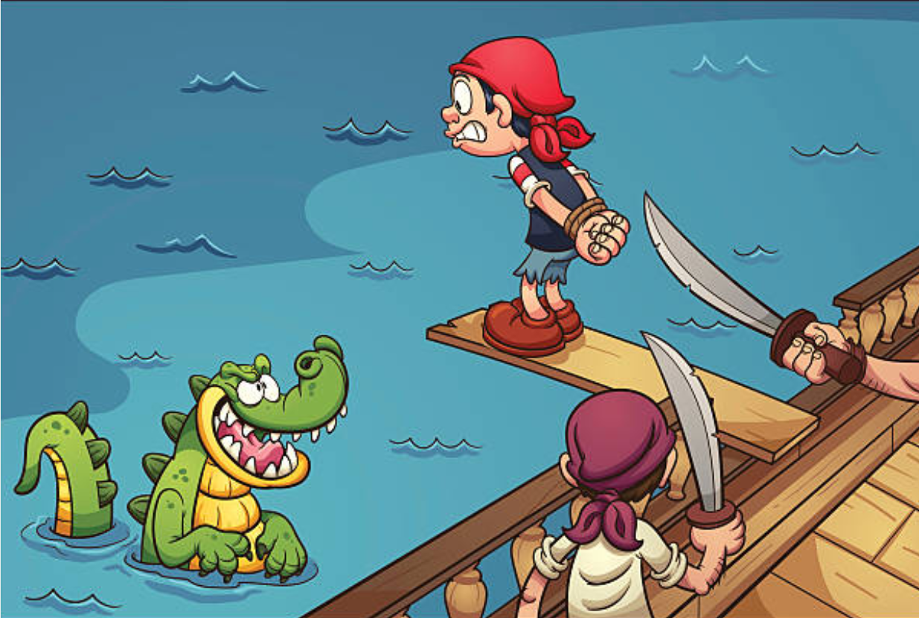
Q & A
Ask us anything… or walk the plank
Slide by: Joshua Rogers

